Slide 1

GLA University
Presentation on
MentDeck
OF
BACHELOR OF ENGINEERING
IN
COMPUTER SCIENCE ENGINEERING
By
Abhinav Bajpai(201500011)
Siddhant Pathak(201500688)
Abhi Maheshwari(201500010)
Under the Guidance of
Mr. Bhanu Kapoor
MentDeck
Page - 1

Slide 2
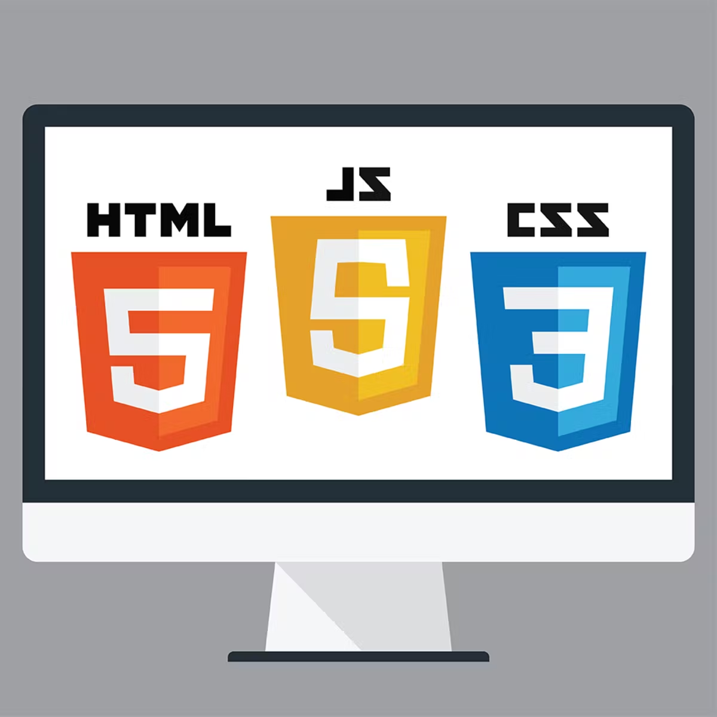
Content
Introduction
Problem Statement
Technology Used
Working
Demo
Conclusion
MentDeck
Page - 2

Slide 3
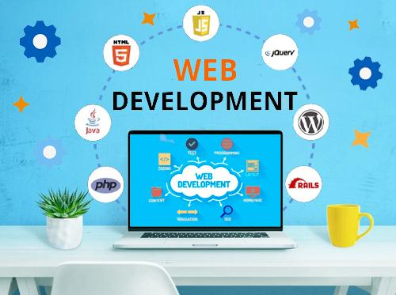
Introduction
Web Development:-
Web development refers to the process of creating websites on the Internet.
The term “Web Development” is relatively broad in its application. You could create a single website page from a wix template, or you could painstakingly develop a massive website with thousands of original pages — and technically, both of those would count as web development.
Nowadays web development is the thing which is in boost.
MentDeck
Page - 3
Notes:
Flutter is an open source framework by Google for building beautiful, natively compiled, multi-platform applications from a single codebase.

Slide 4
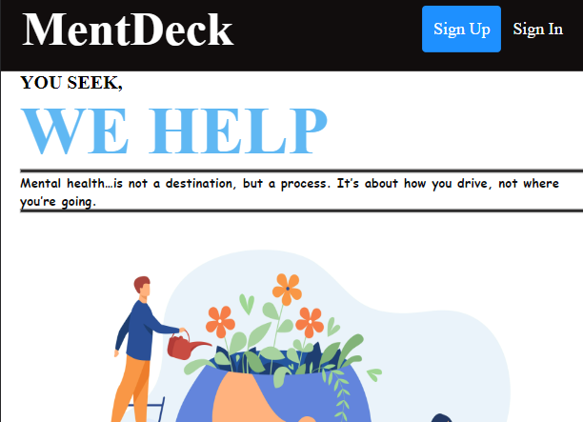
MentDeck
Introduction
MentDeck
MentDeck, a website dedicated to mental health patients
Works on any browser
Login Screen
Home Screen with all the services provided
A page dedicated to mental health related Questions
A Survey form to collect data of the patients
Technology Used -
HTML5
CSS
PHP
MentDeck
Page - 4
Notes:
Flutter is an open source framework by Google for building beautiful, natively compiled, multi-platform applications from a single codebase.

Slide 5



Problem Statement
A bridge between doctors and those suffering from mental health issues.
A platform to create a platform for patients to connect to doctors.
MentDeck
Page - 5
Notes:
Flutter is an open source framework by Google for building beautiful, natively compiled, multi-platform applications from a single codebase.

Slide 6
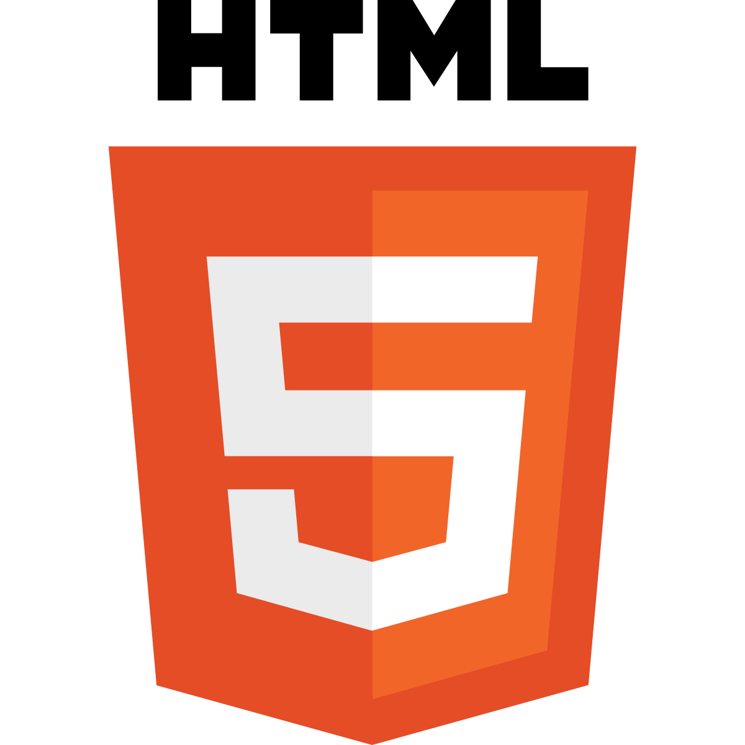
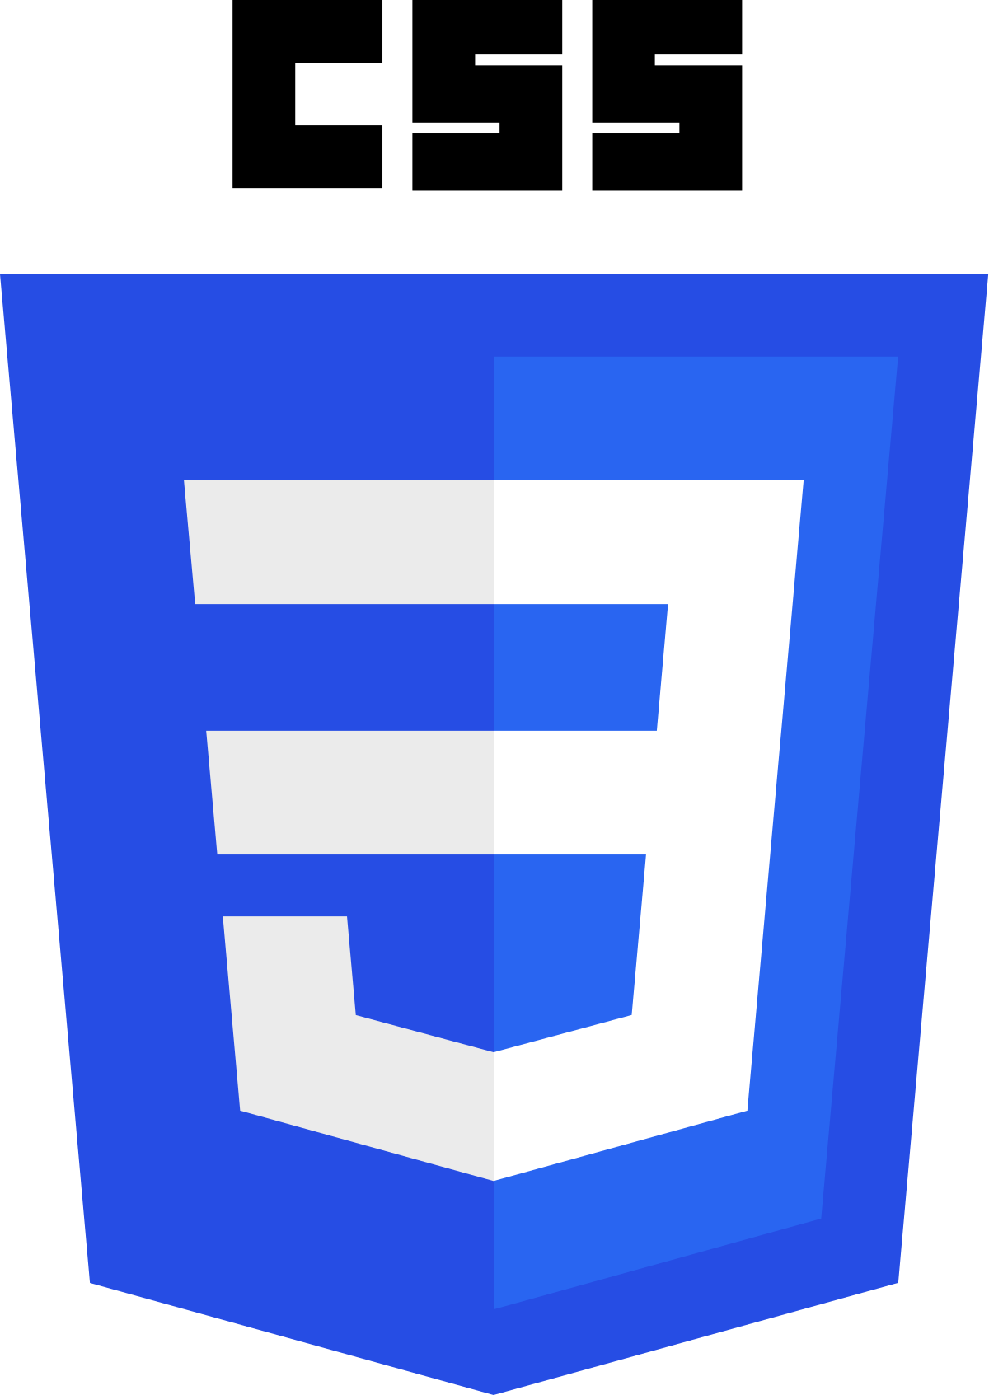
Technology Used
HTML
HTML is an acronym which stands for Hyper Text Markup Language which is used for creating web pages and web applications. Let's see what is meant by Hypertext Markup Language, and Web page.
CSS stands for Cascading Style Sheets. It is a style sheet language which is used to describe the look and formatting of a document written in markup language. It provides an additional feature to HTML. It is generally used with HTML to change the style of web pages and user interfaces. It can also be used with any kind of XML documents including plain XML, SVG and XUL.
MentDeck
Page - 6
Notes:
Flutter is an open source framework by Google for building beautiful, natively compiled, multi-platform applications from a single codebase.

Slide 7


Technology Used
PHP
PHP is an open-source, interpreted, and object-oriented scripting language that can be executed at the server-side. PHP is well suited for web development. Therefore, it is used to develop web applications (an application that executes on the server and generates the dynamic page.).
BOOTSTRAP
It includes HTML and CSS based design templates for typography, forms, buttons, tables, navigation, modals, image carousels and many others.
It can also use JavaScript plug-ins.
MentDeck
Page - 7
Notes:
Flutter is an open source framework by Google for building beautiful, natively compiled, multi-platform applications from a single codebase.

Slide 8
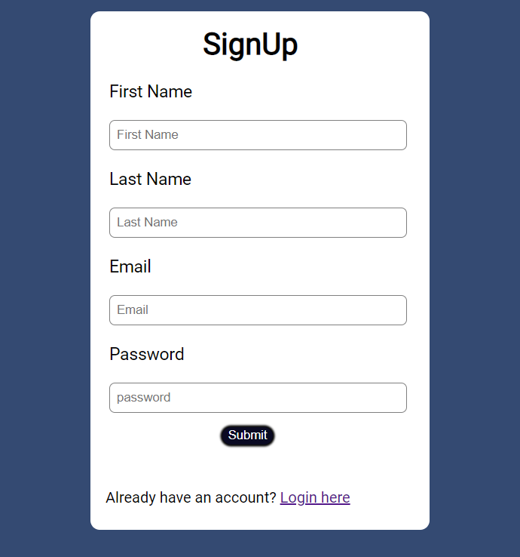
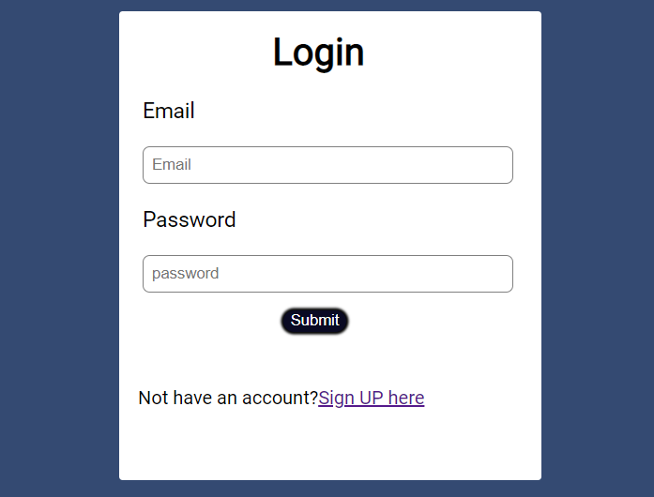
Working
MentDeck
Page - 9
Notes:
Flutter is an open source framework by Google for building beautiful, natively compiled, multi-platform applications from a single codebase.

Slide 9
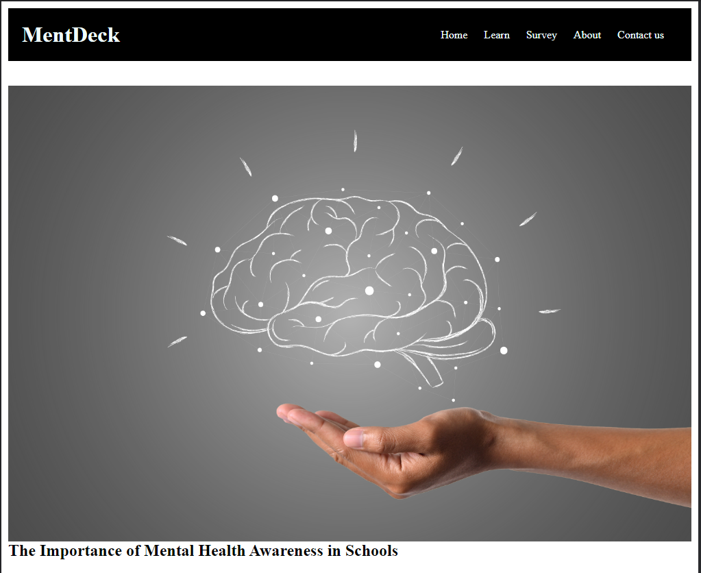
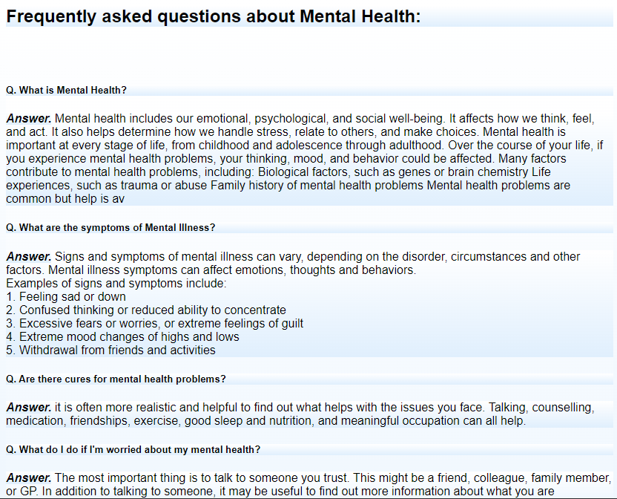
Working
MentDeck
Page - 10

Slide 10
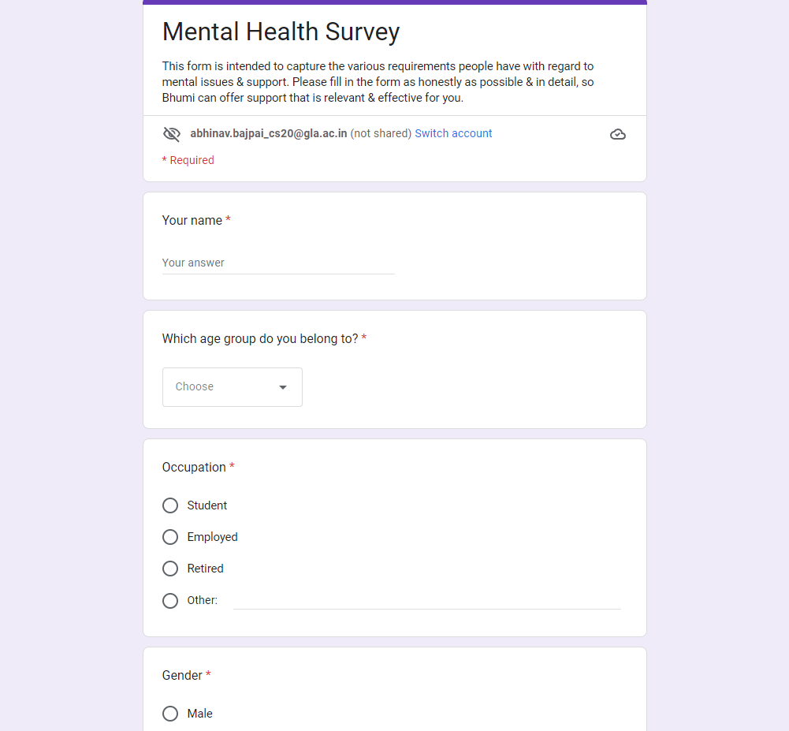
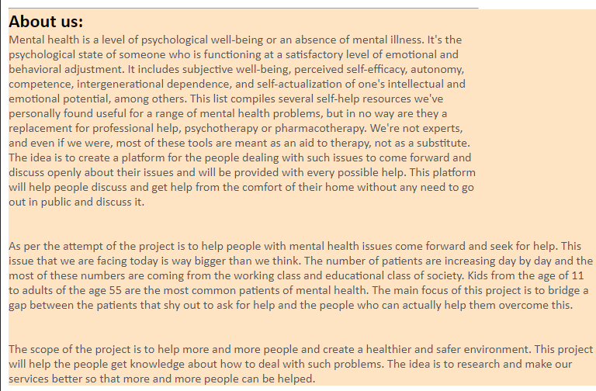
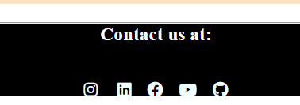
Working
MentDeck
Page - 11
Notes:
Flutter is an open source framework by Google for building beautiful, natively compiled, multi-platform applications from a single codebase.

Slide 11
Conclusion
MentDeck bridges the gap between the Mental health patients with the use of help of technology so that they can get connected to the best doctors around and get all the help needed.
Also it creates a safe environment where Patients can share their thoughts.
Future work concerns with developing a Admin panel and a database to store products detail with a proper management system.
MentDeck
Page -14
Notes:
Flutter is an open source framework by Google for building beautiful, natively compiled, multi-platform applications from a single codebase.

Slide 12
Thanks
AI RADIO
Page -15
Notes:
Flutter is an open source framework by Google for building beautiful, natively compiled, multi-platform applications from a single codebase.

